Slide 1
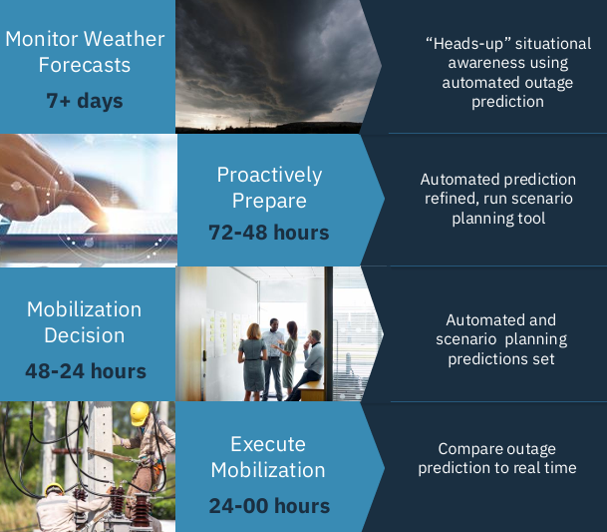

Slide 2
Problem statement
As climate change intensifies, vulnerable communities around the world face increasingly frequent and severe climate disasters such as heavy rains, floods, and earthquakes that threaten lives, livelihoods, and infrastructure.
Yet timely, accurate, and context-specific information about these events remains difficult to access, especially for decision-makers, emergency responders, and local leaders working to protect at-risk populations.
Current solutions such as manual document search or generic AI chatbot often lack the specificity, reliability, and up-to-date information needed to support effective climate resilience planning. Without real-time, data-driven insights tailored to specific regions and event types, communities struggle to prepare for and respond to these disasters, leaving them highly vulnerable.
Therefore, there is an urgent need for a solution that combines real-time climate intelligence with advanced AI capabilities to answer climate disaster questions accurately and efficiently enabling faster, data-driven decisions that can save lives and build resilience in the face of an escalating climate crisis.

Slide 3

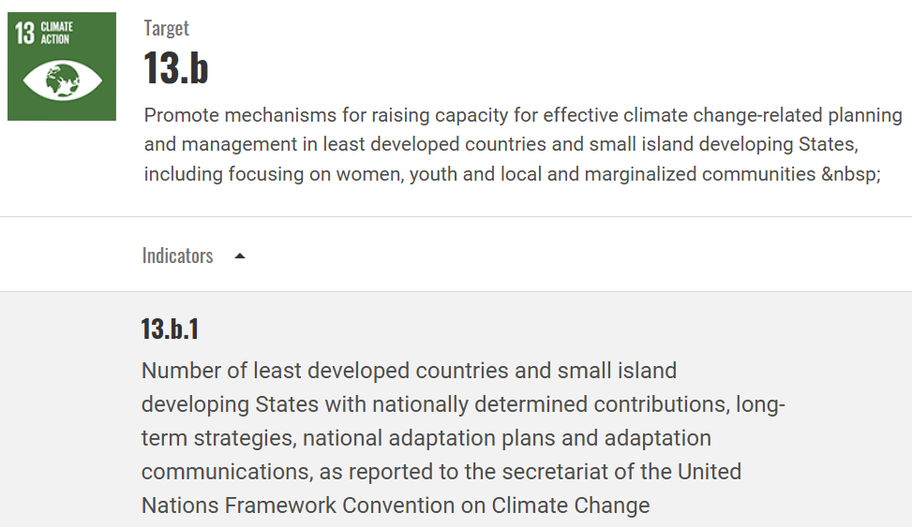

Slide 4
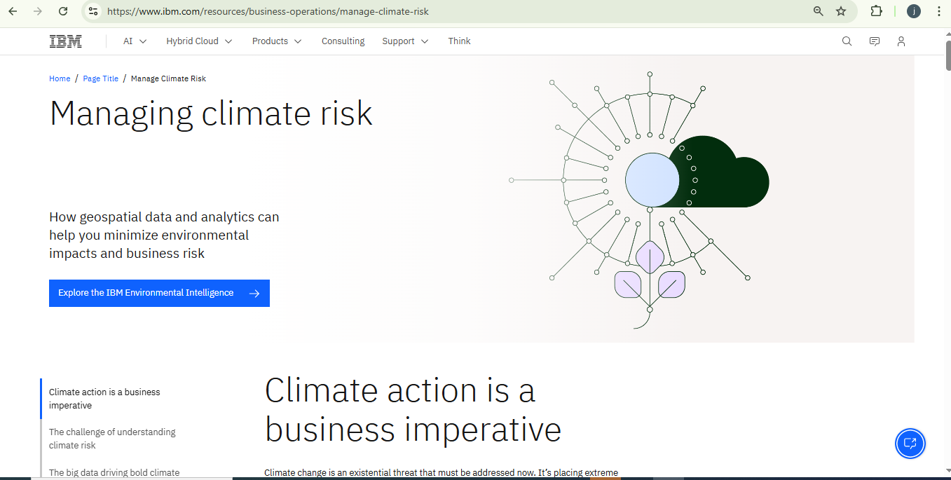

Slide 5
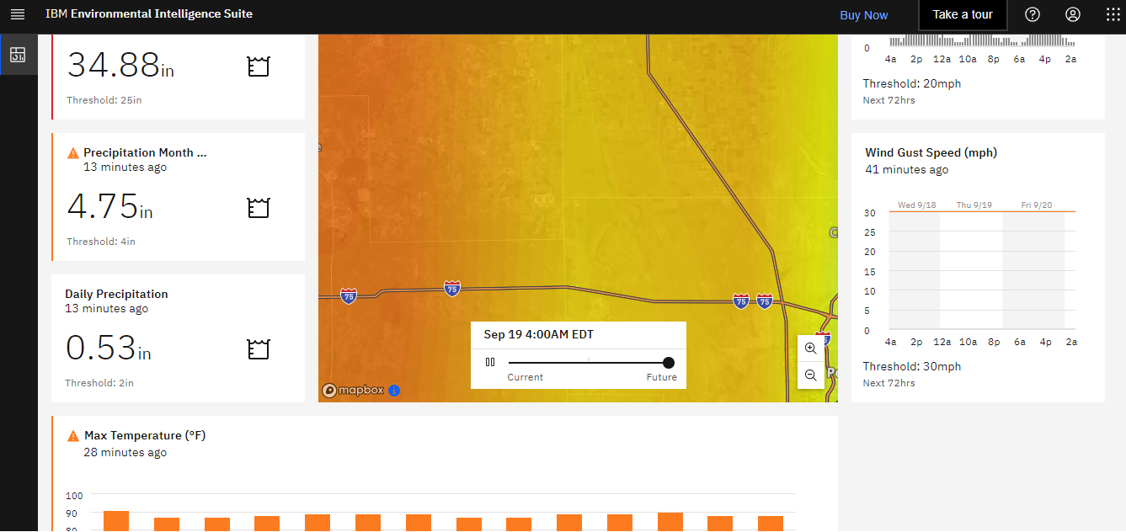

Slide 6
Solution
Step | Component | Purpose
1️⃣ | IBM EIS | Collect real-world climate event data
2️⃣ | SentenceTransformers | Encode events and queries into embeddings
3️⃣ | Elasticsearch SDK | Store and search climate events with vector search
4️⃣ | LangChain RAG Pipeline | Orchestrate retrieval of context and answer generation
5️⃣ | IBM Watsonx.ai | Generate natural language answers
6️⃣ | User Interface | Enable users to interact and get answers

Slide 7
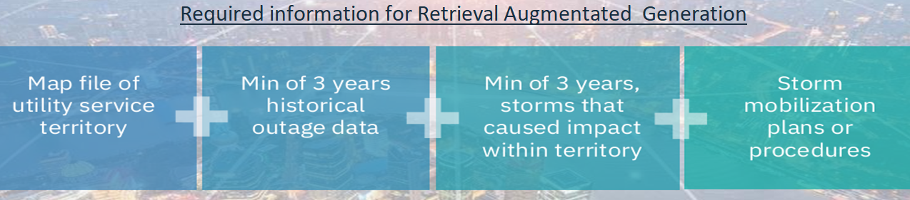
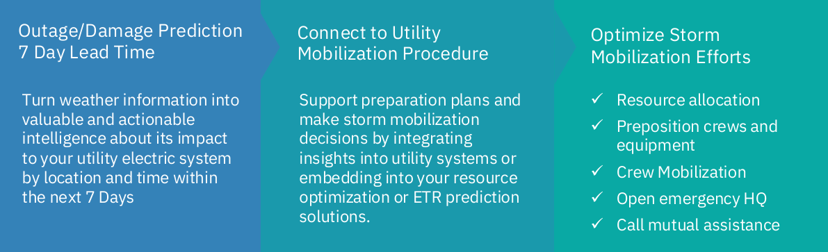
Objectives

Slide 8
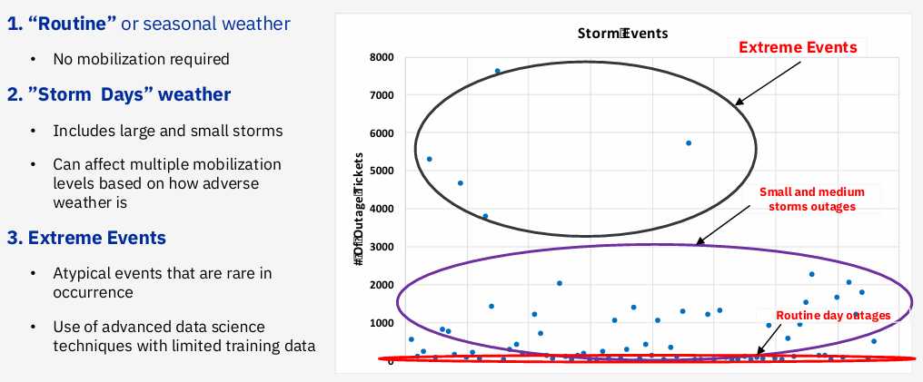

Slide 9
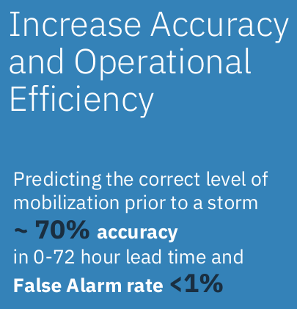
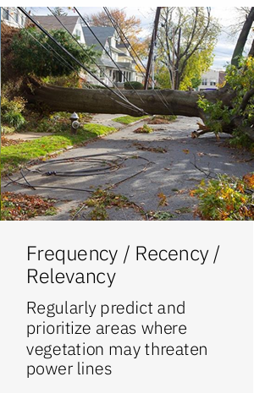
Use Case

Slide 10
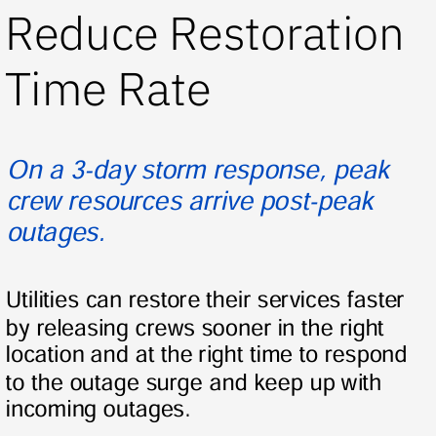
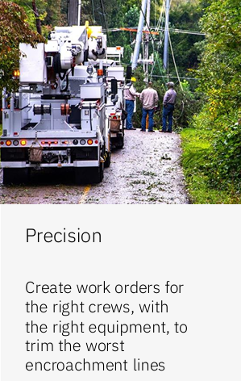
Use Case

